Slide 1
A comparative Study of Dijkstra’s Algorithm and the Graph p-eikonal Method
Jiaqi Wang; N16367706; CO2026
Mentor: Hong-Bin Chen
New York University Shanghai
April 29, 2026

Slide 2
My research
Research focus
Study a mathematically defined graph propagation model
Evaluate how p affects path behavior in practice
Compare fidelity, robustness, and parameter sensitivity
Analysis of PDE
Main contribution
Build an experimental evaluation framework
Show how graph p-eikonal methods differ from Dijkstra’s algorithm under clean and noisy settings
My
research
Data
Science/
Machine
Learning
Shortest
Paths

Slide 3
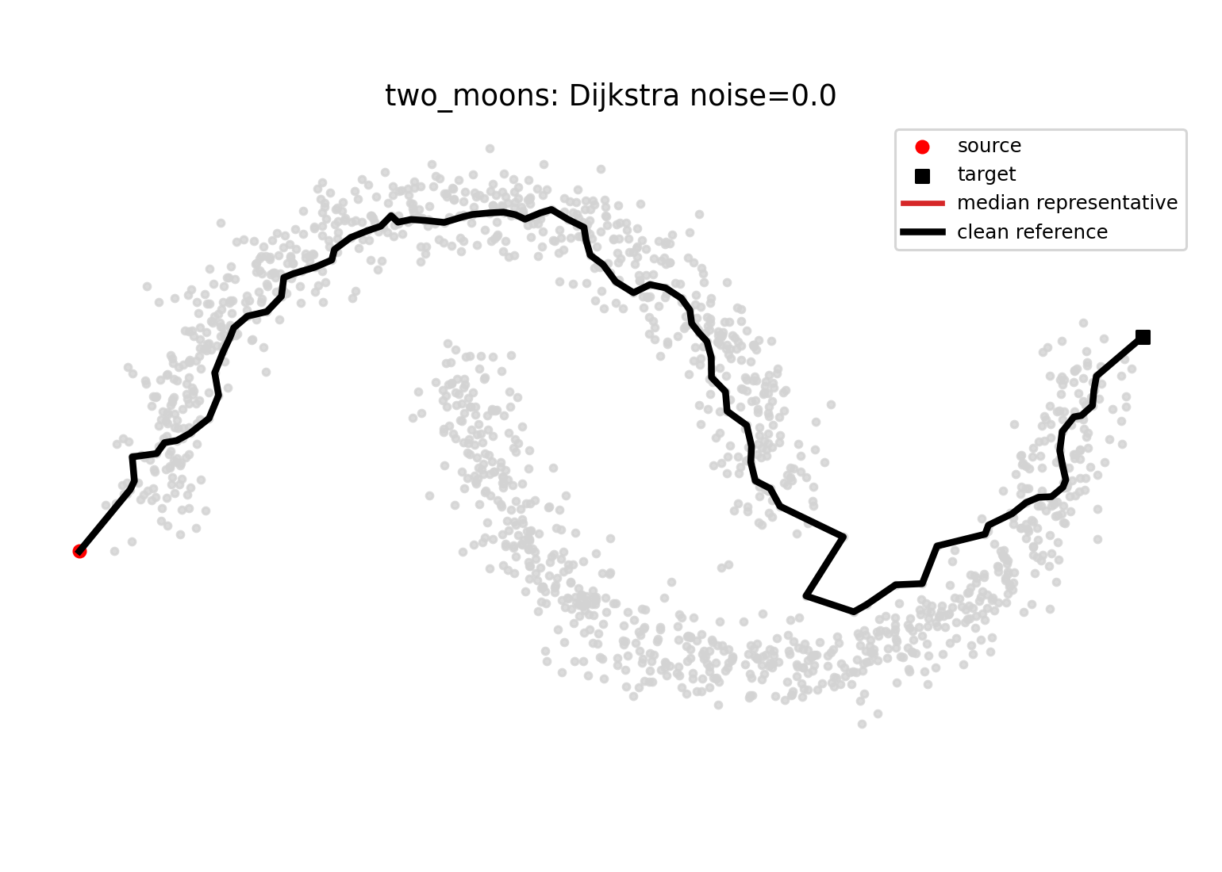
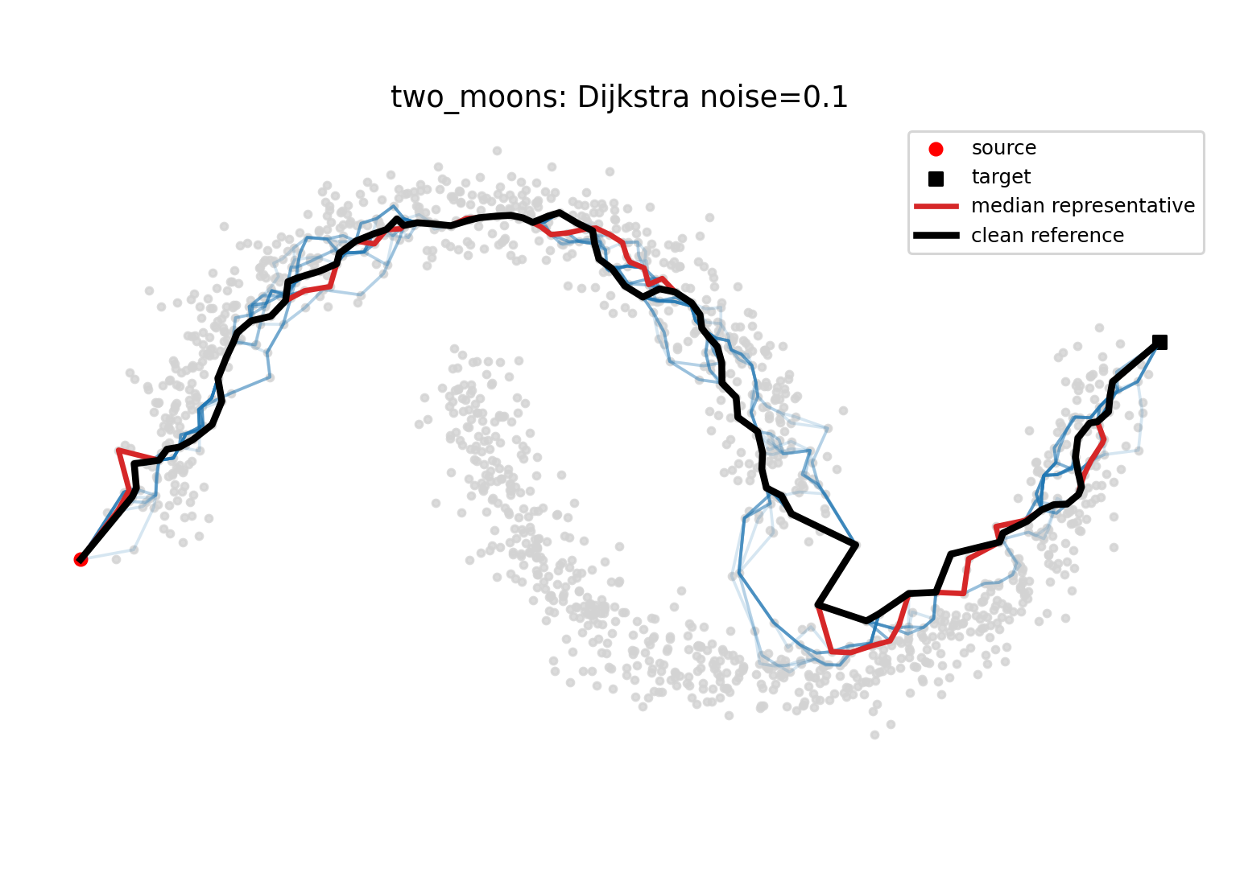
Motivation: Path behavior under noise settings
Shortest path distances are widely applied in data science and machine learning.
01
02
Dijkstra’s algorithm gives clear shortest paths,
but the paths may not be robust under noise settings.
03
Graph p-eikonal method is theoretically more robust
that Dijkstra’s algorithm under noise settings.
Is this robustness reflected in practice? How does p
reflect graph p-eikonal method’s path behavior?
04

Slide 4
Goal: Path behavior comparison among Dijkstra’s algorithm, and different p-eikonal
How does p affect fidelity?
Fidelity is defined by the extent to which the paths produced by the p-eikonal method deviate from those reference paths in terms of cost.
01
How does p affect robustness?
02
Robustness refers to whether paths produced for a fixed p remains stable under different levels of weighted noise.
Is there a usable rule for selecting p?
03
What is the optimal p? Does there exist a practical
Principle for choosing at least a range of p?

Slide 5
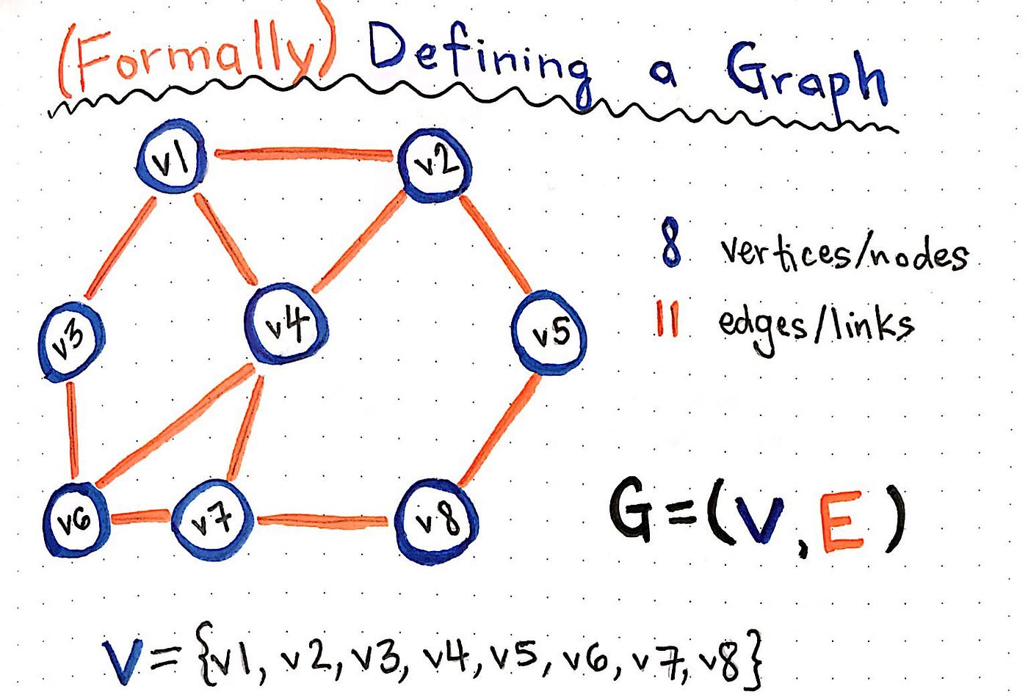


Mathematical background 1:
Definitions of graph
Weight of edge v_i and v_j:
w_ij , connection , distance
Weight matrix:
Gradient:
Boundary: (set of terminal points)

Slide 6



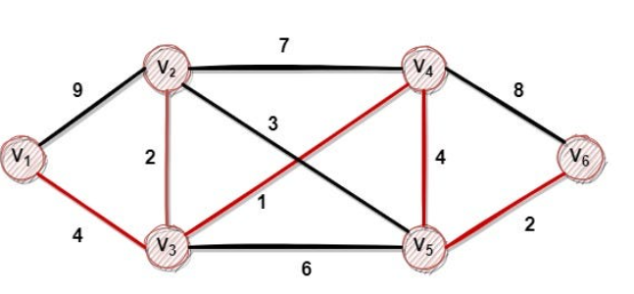
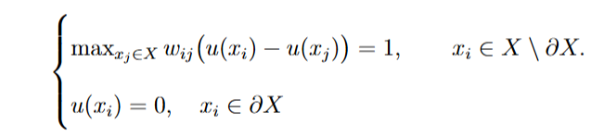
Mathematical background 2:
Dijkstra’s algorithm
The Bellman relation (u is the distance to the terminal vertex)
Graph distance between x_i and x_j:
The Bellman relation (rewritten)

Slide 7

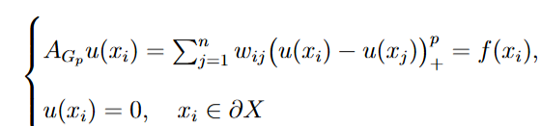

Mathematical background 3:
Graph p-eikonal method
Goal: mitigate over reliance on a single neighbor
Upwind neighbors
Graph p-eikonal equation
p-eikonal operator
p=1: most robust; p infinity: Bellman relation

Slide 8
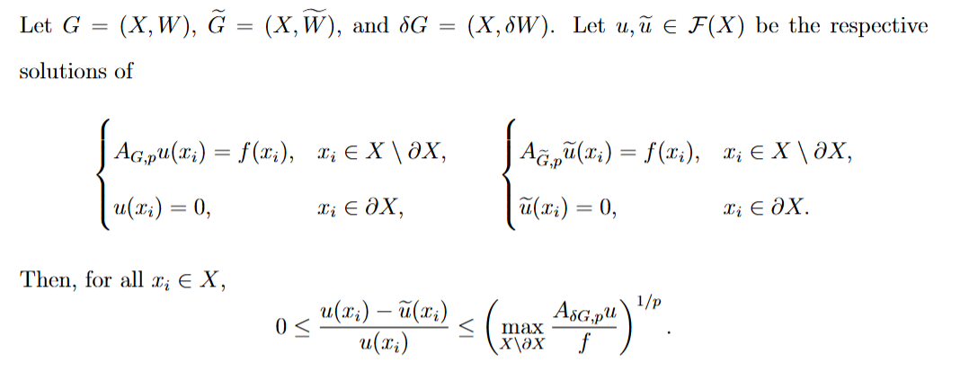
Mathematical background 4:
Properties of the p-eikonal equation
(Existence and Uniqueness): p>0, f>0, then the p-eikonal equation admits a
a unique solution u.
(Robustness related to nonnegative noise):
(Comparability with distance): Let K be the number of edges. Then

Slide 9
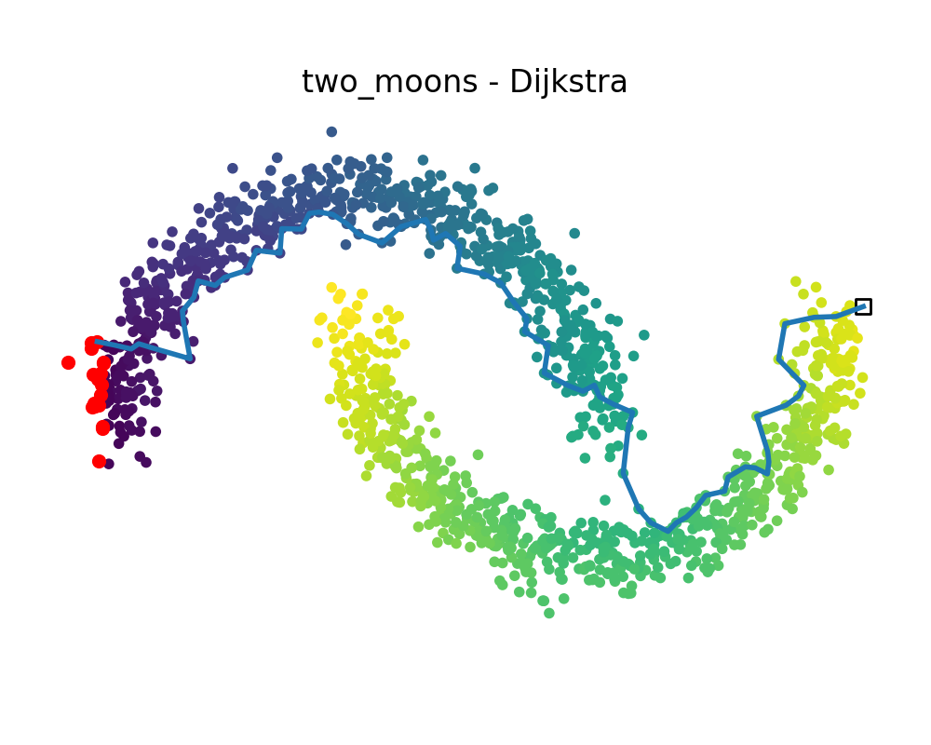
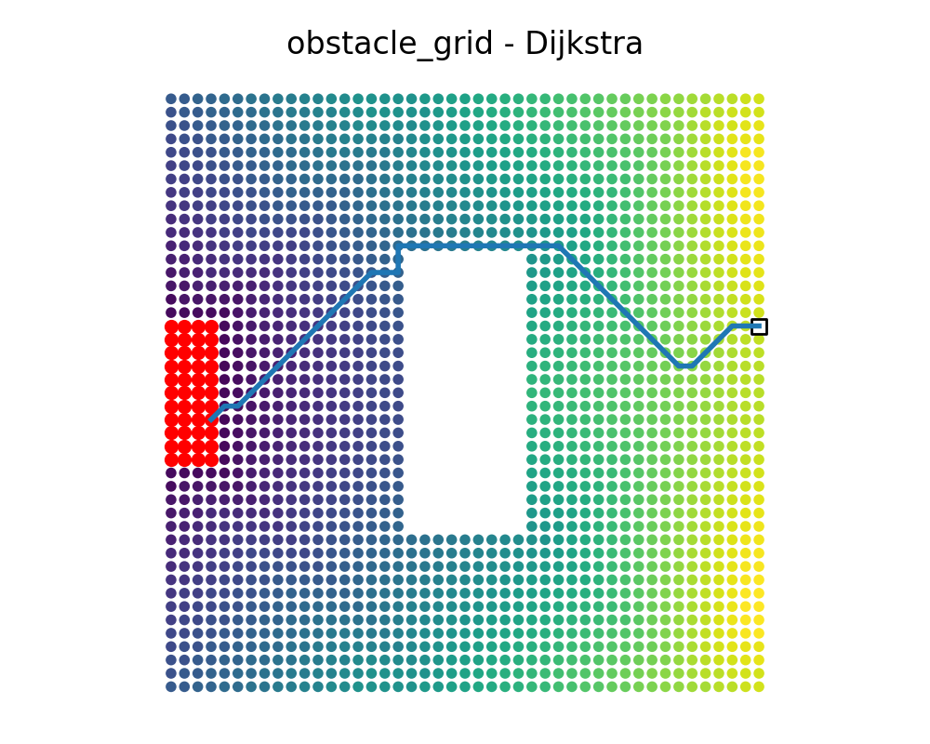
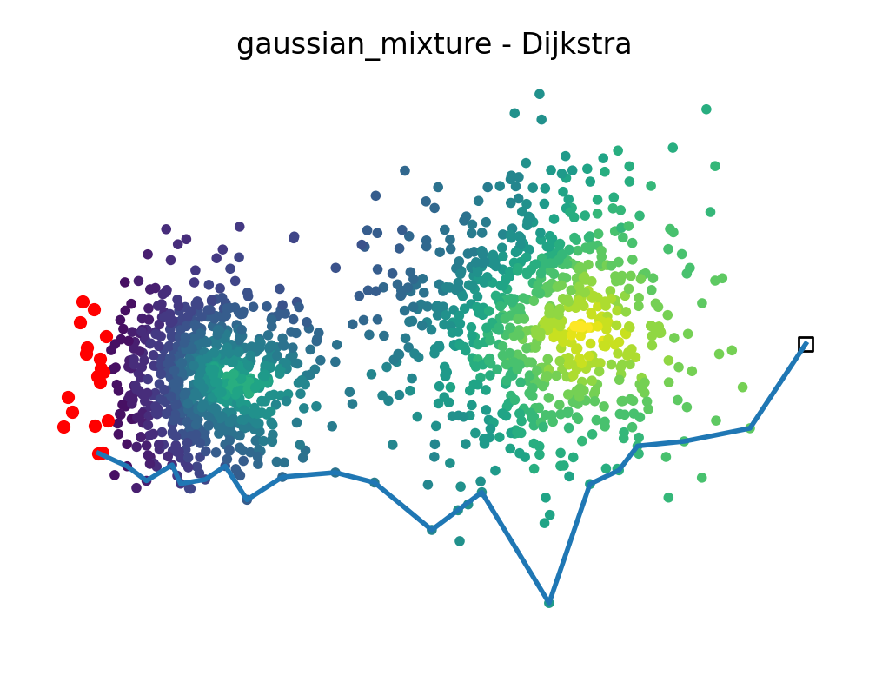
Experiment settings 1:
Datasets selection and graph construction
Structure: Non-convex manifold
Purpose: Tests whether paths follow manifold geometry
Structure: Grid graph with obstacles
Purpose: Tests obstacle avoidance and constrained propagation
Structure: Clustered data with nonuniform density
Purpose: Test propagation across sparse regions

Slide 10
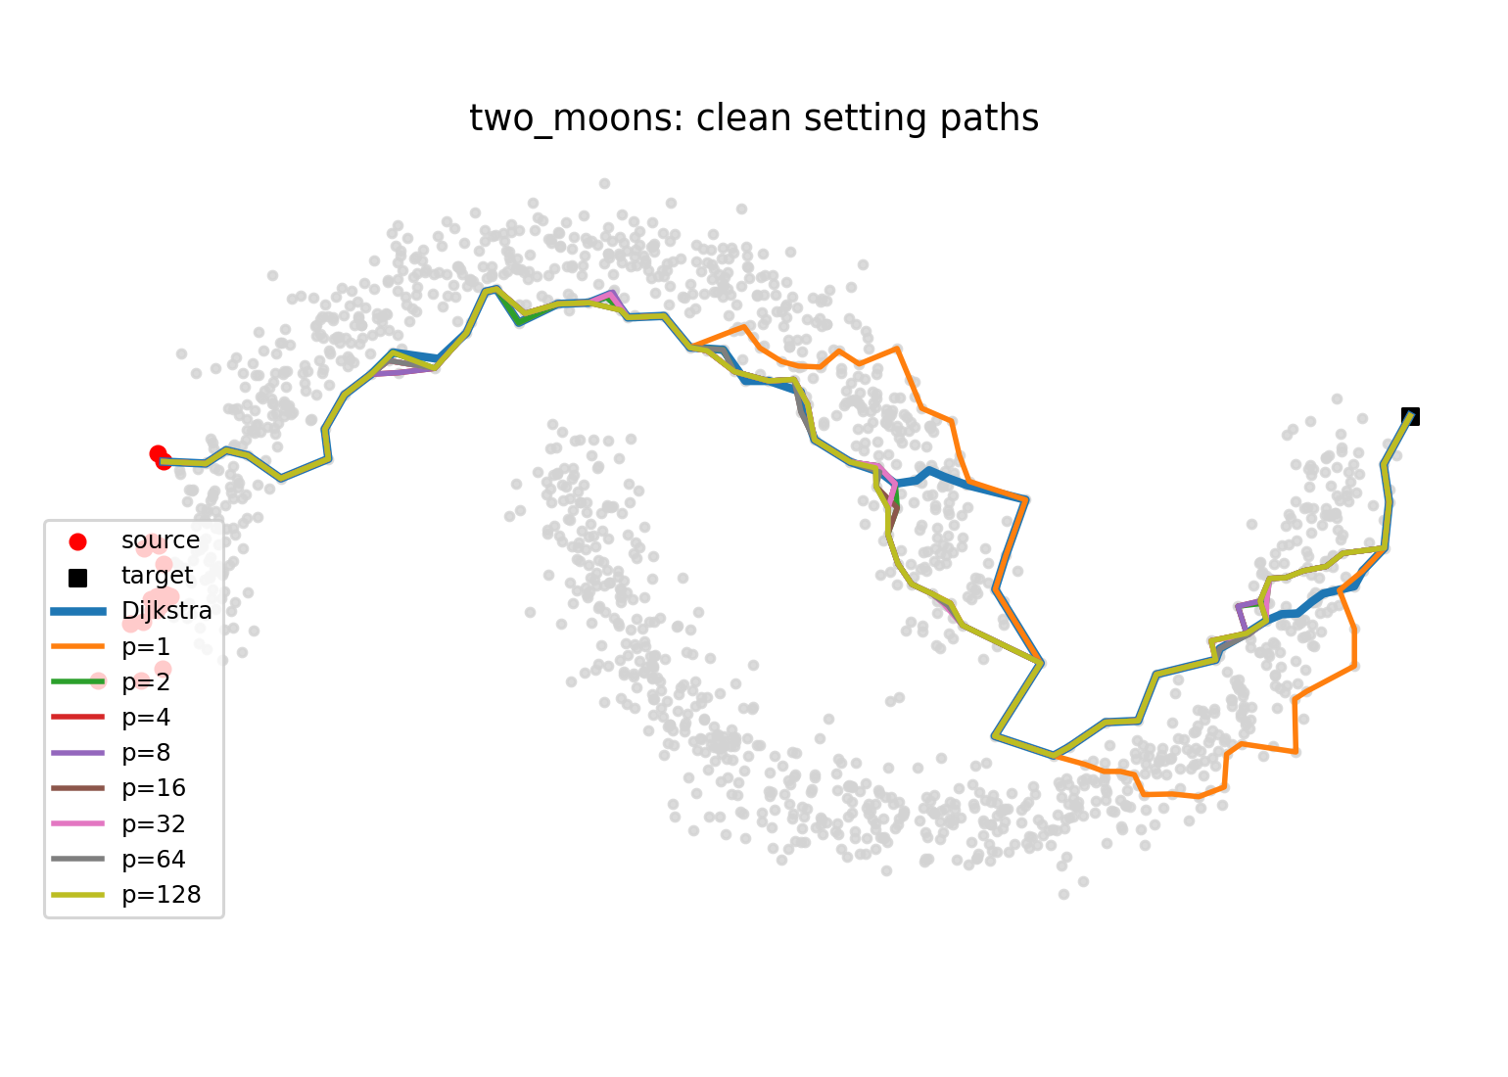



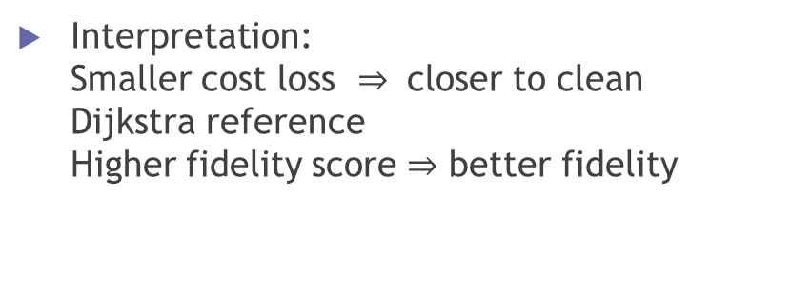
Experiment settings 2:
Fidelity metric
Purpose: To measure a solution path’s agreement with the Dijkstra’s algorithm’s solution path in terms of cost
Fidelity loss:
Interpretation: Smaller cost loss $⇒$ closer to clean Dijkstra reference Higher fidelity score $⇒$ better fidelity
Fidelity loss:

Slide 11
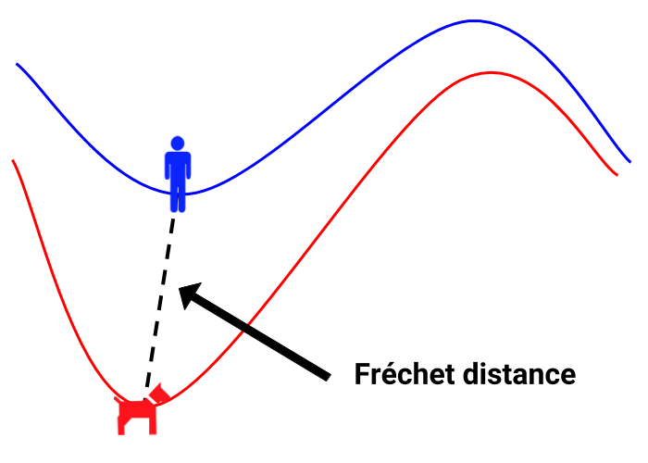
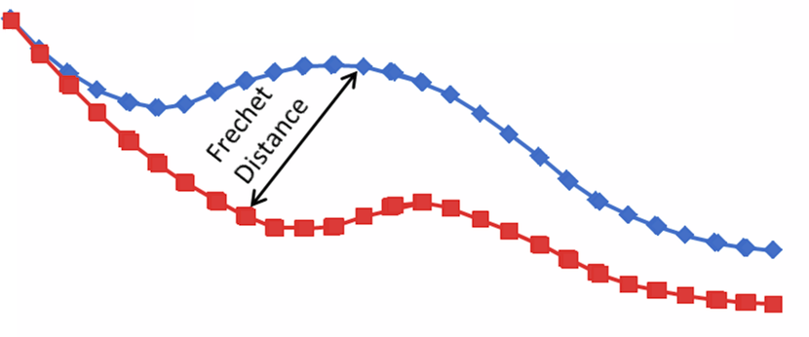
Experiment settings 3:
Path similarity metric: Discrete Frechet Distance
Purpose: To measure similarity between two ordered path. Given two fixed paths, what is the shortest leash length that allows a person and a dog to traverse their paths without moving backward?
A forward-only matching: For two paths P=(u1,u2…,up) and Q=(v1,v2,…vq), a forward-only matching is a sequence of matched pairs that satisfies: 1.starts at (u1,v1) and ends at (up,vq); 2.at each step, one may move forward along a path or along both paths simultaneously. Backward movement is not allowed
Among all forward-only matchings between the two paths, we want to find the matching with the minimal maximum distance between matched pairs.

Slide 12



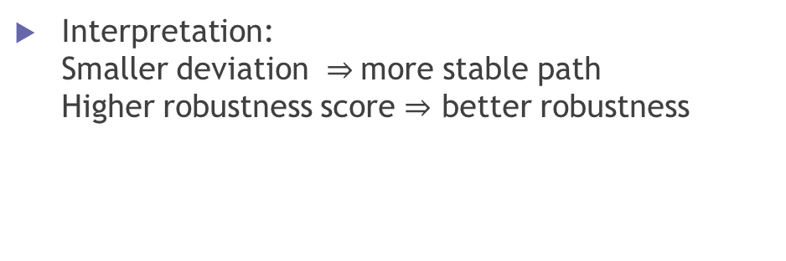
Experiment settings 4:
Robustness metric
Purpose: To measure a method’s solution path stability under weighted noise compared with their clear reference solution path
Path deviation under noise condition epsilon:
Robustness loss:
Interpretation: Smaller deviation $⇒$more stable path Higher robustness score $⇒$ better robustness

Slide 13
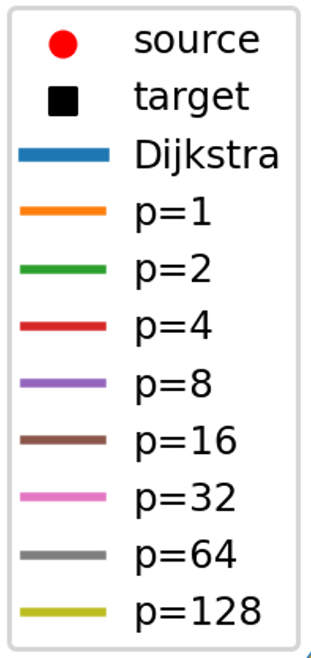
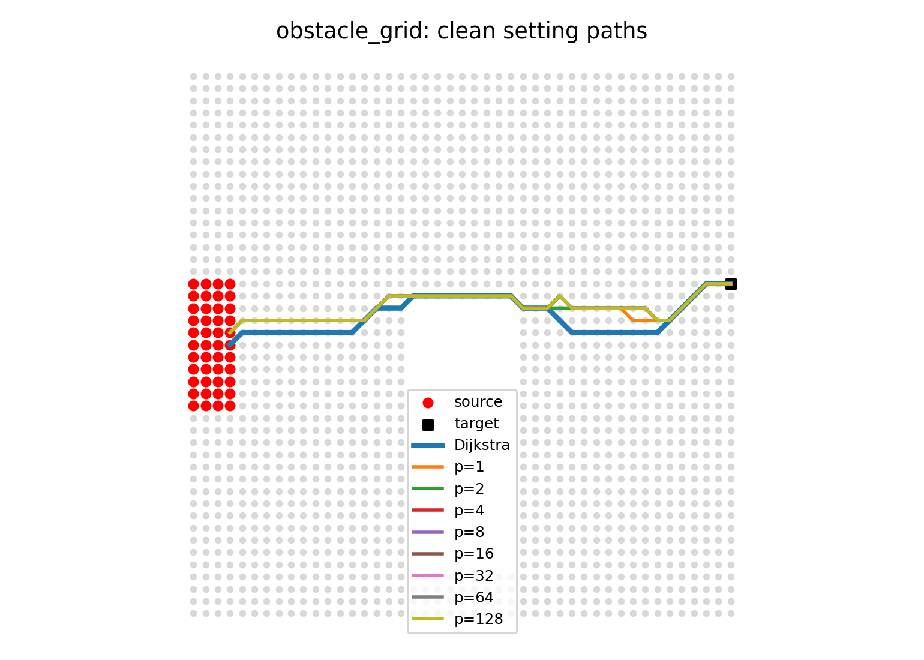
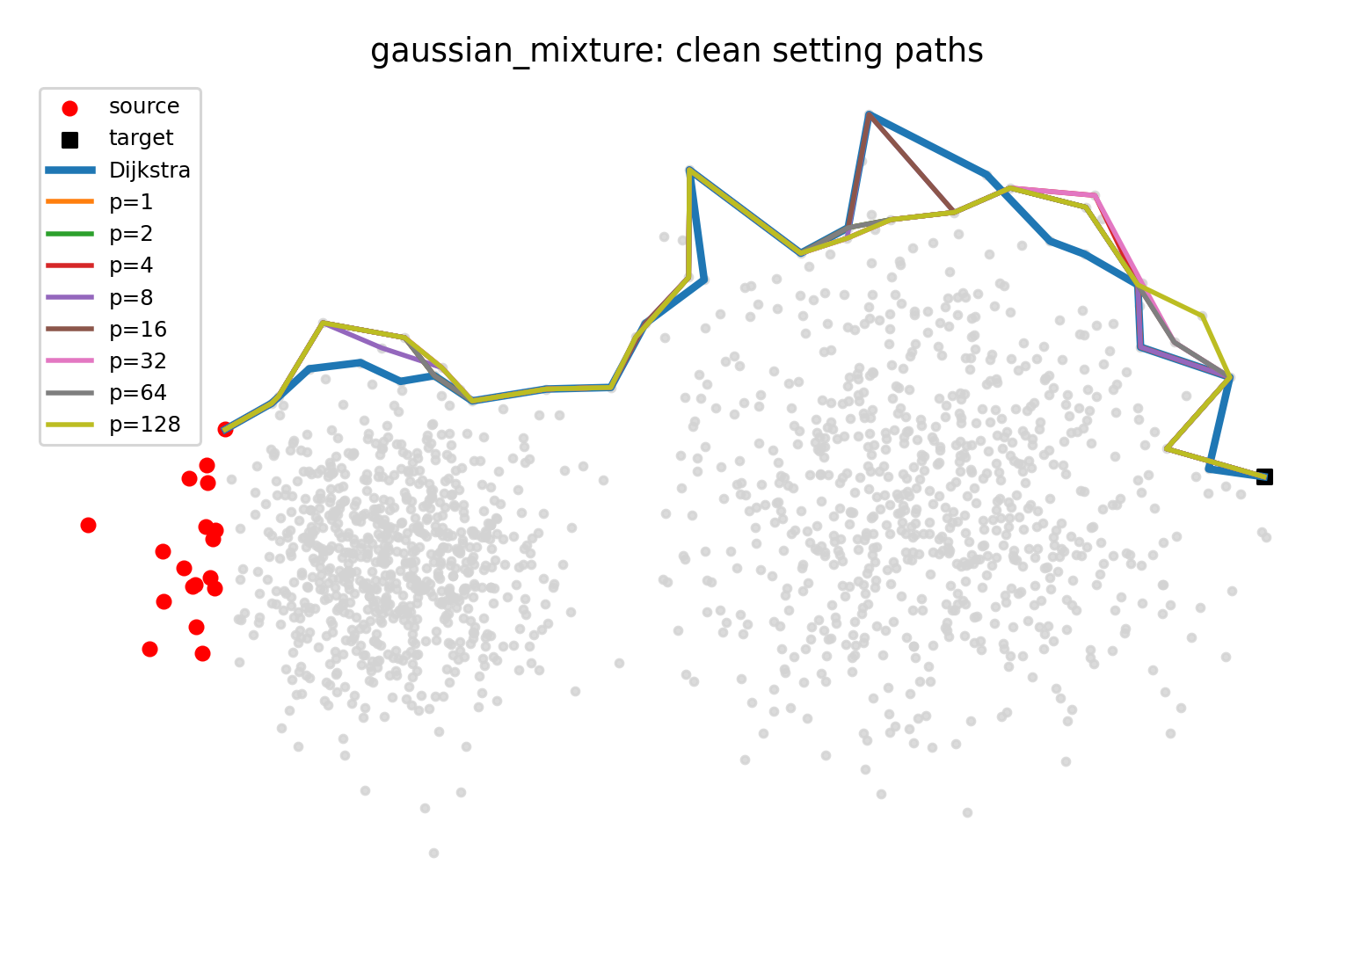
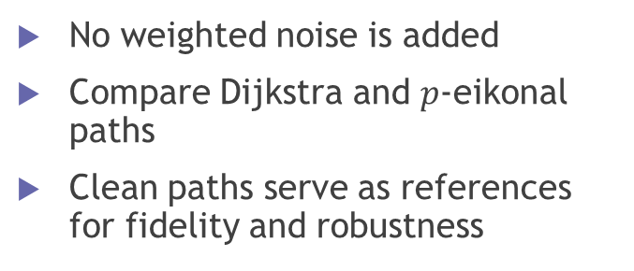
Results and Discussion 1:
Clean setting overview
No weighted noise is added
Compare Dijkstra and $p$-eikonal paths
Clean paths serve as references for fidelity and robustness
The effect of p depends on dataset geometry: strongest on Two Moons, moderate on Obstacle Grid, and weakest on Gaussian Mixture

Slide 14
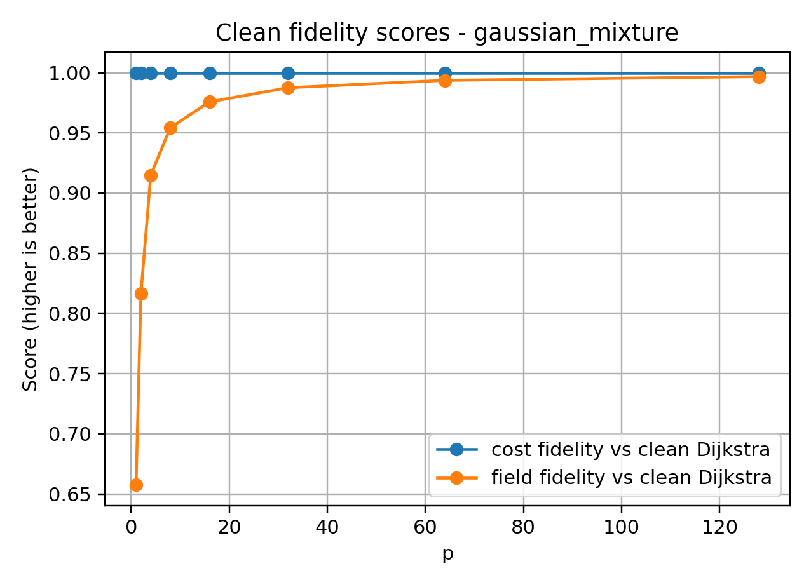
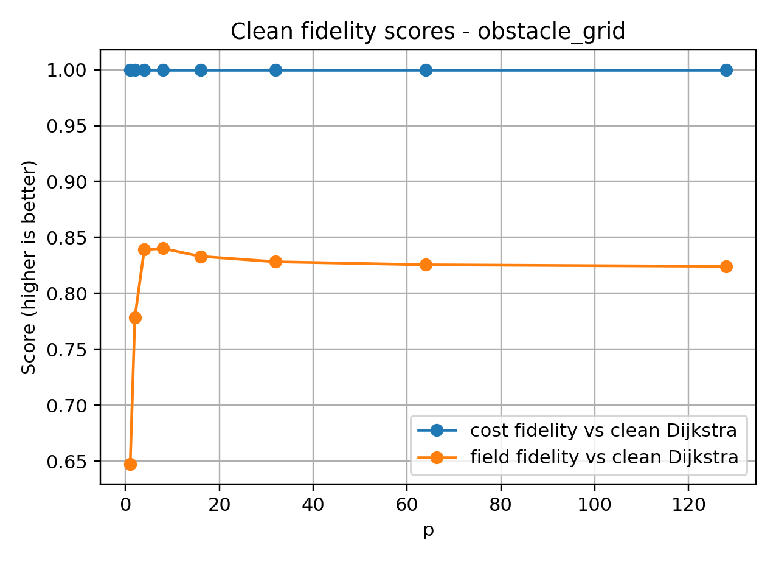
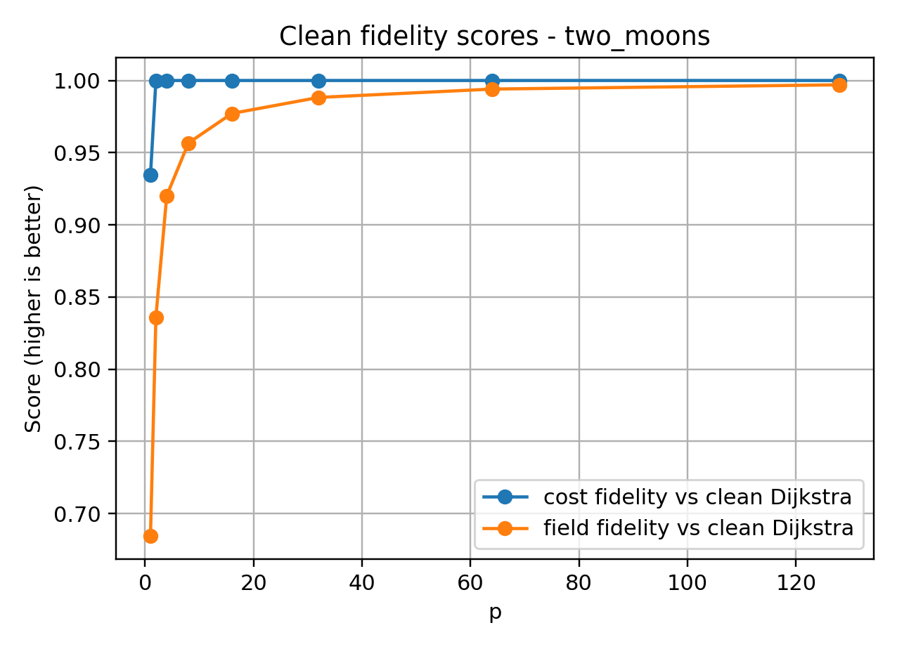
Results and Discussion 2:
Clean Fidelity
Cost-based fidelity is close to 1 for many p values
Small p may show lower fidelity on some datasets
Fidelity alone is often not enough for parameter selection

Slide 15
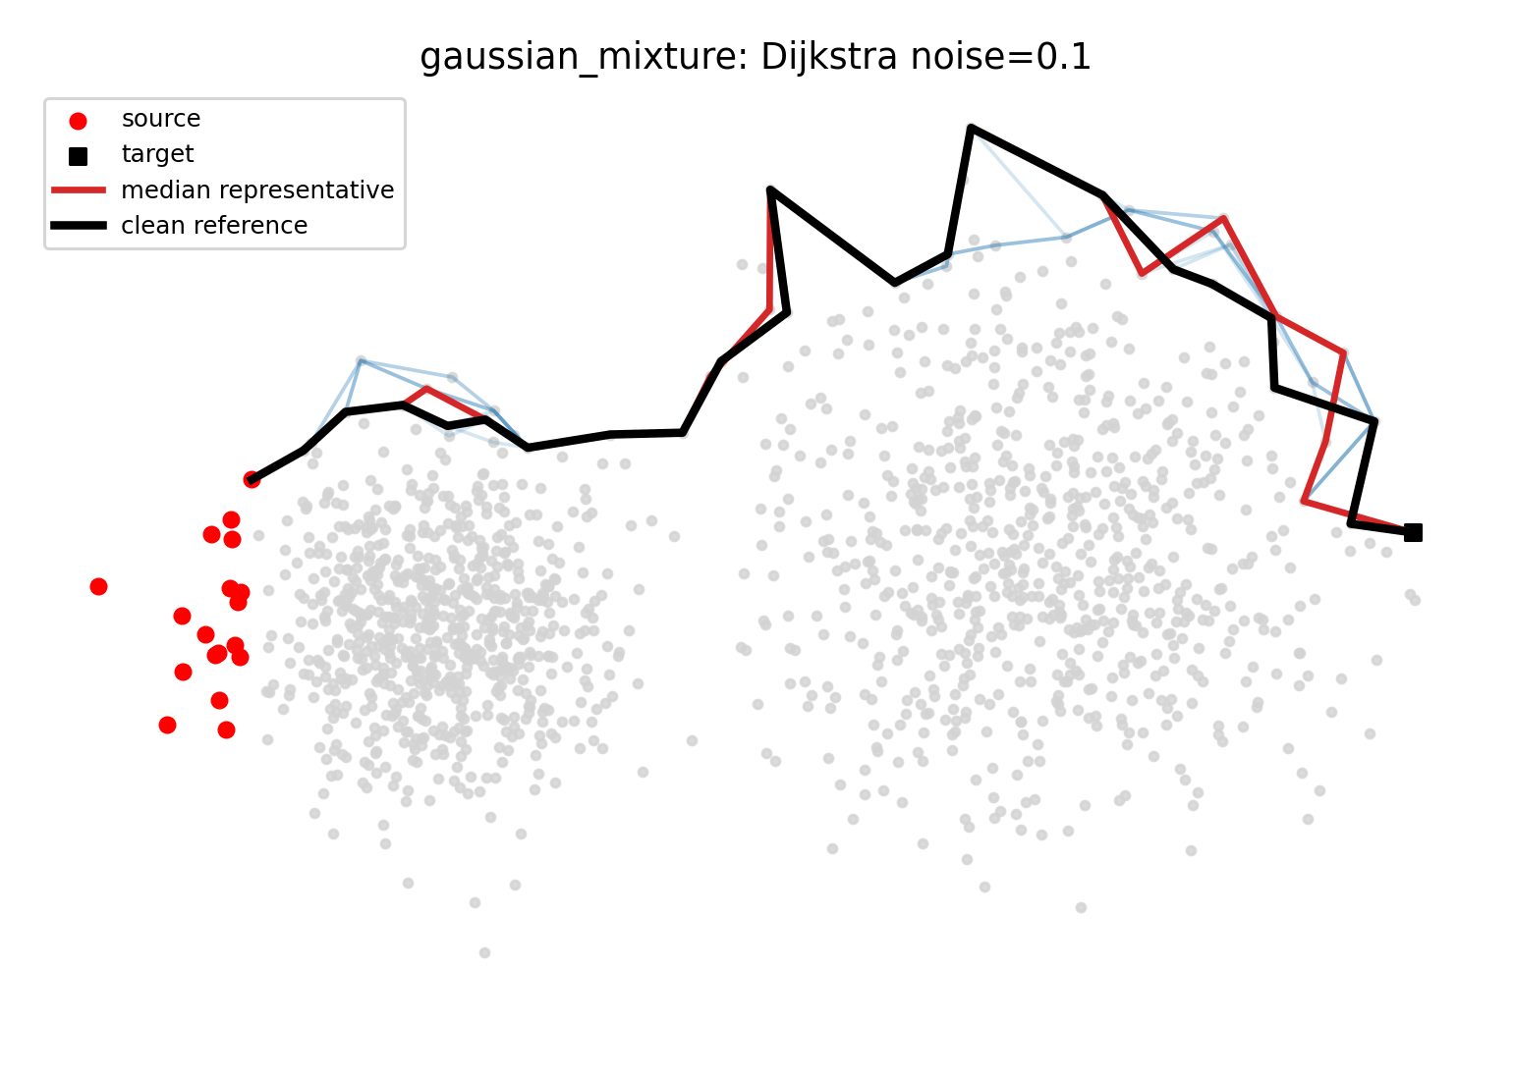
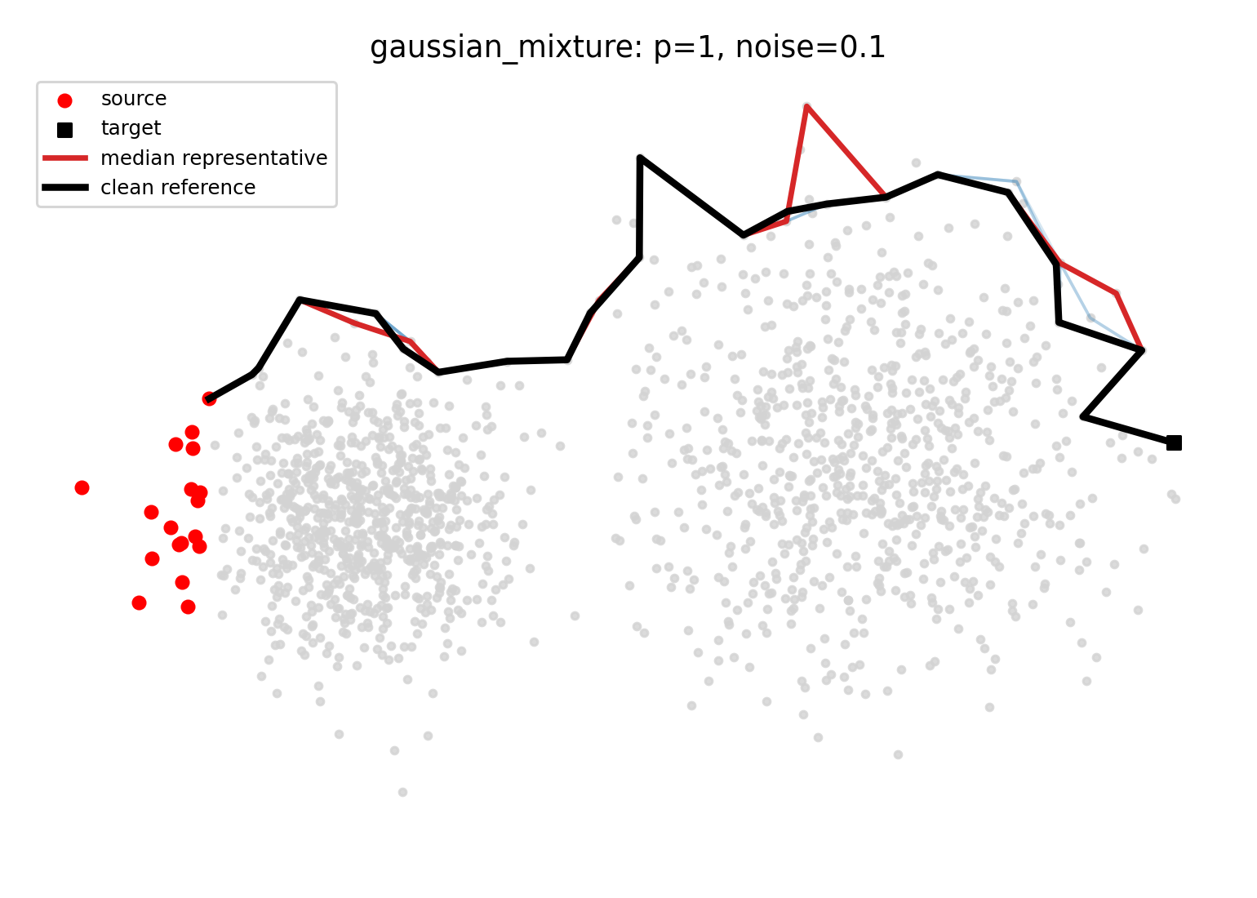
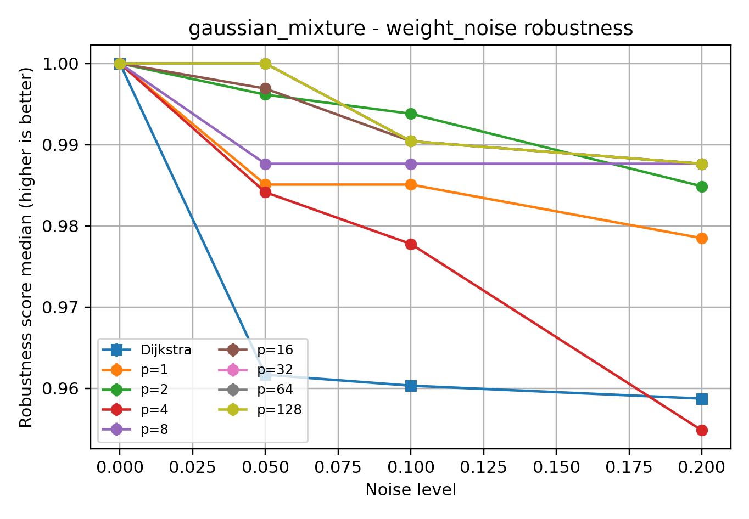
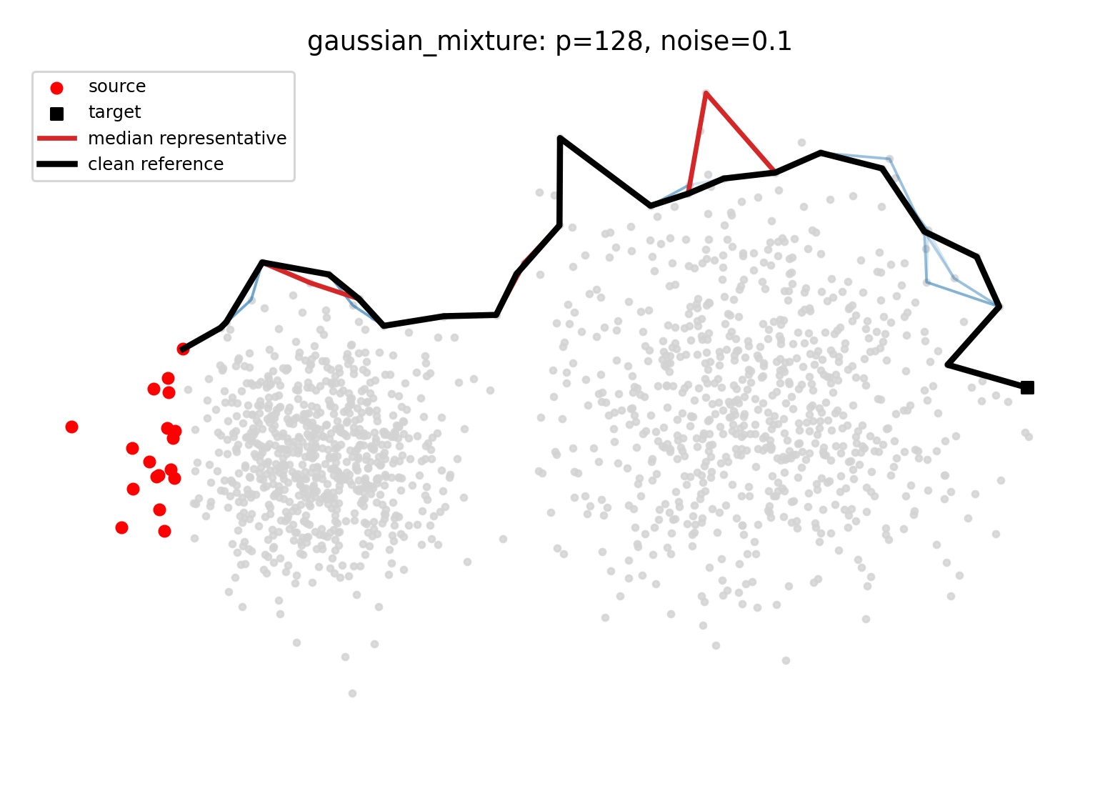
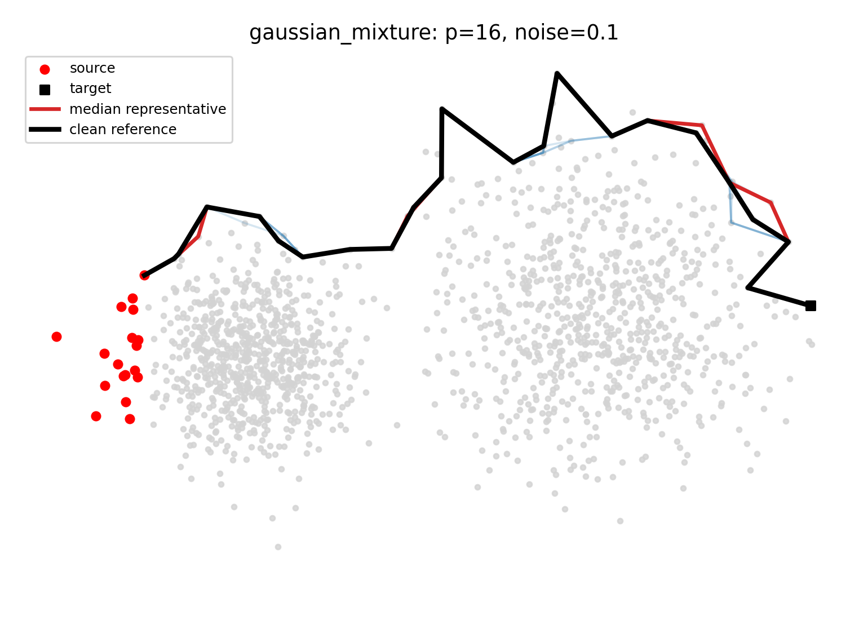
Results and Discussion 3:
Gaussian Mixture
Dijkstra shows visible path deviation under noise
p-eikonal paths stay closer to the clean reference
Larger p values show higher robustness in this dataset
p-eikonal propagation is more stable than discrete shortest-path selection

Slide 16
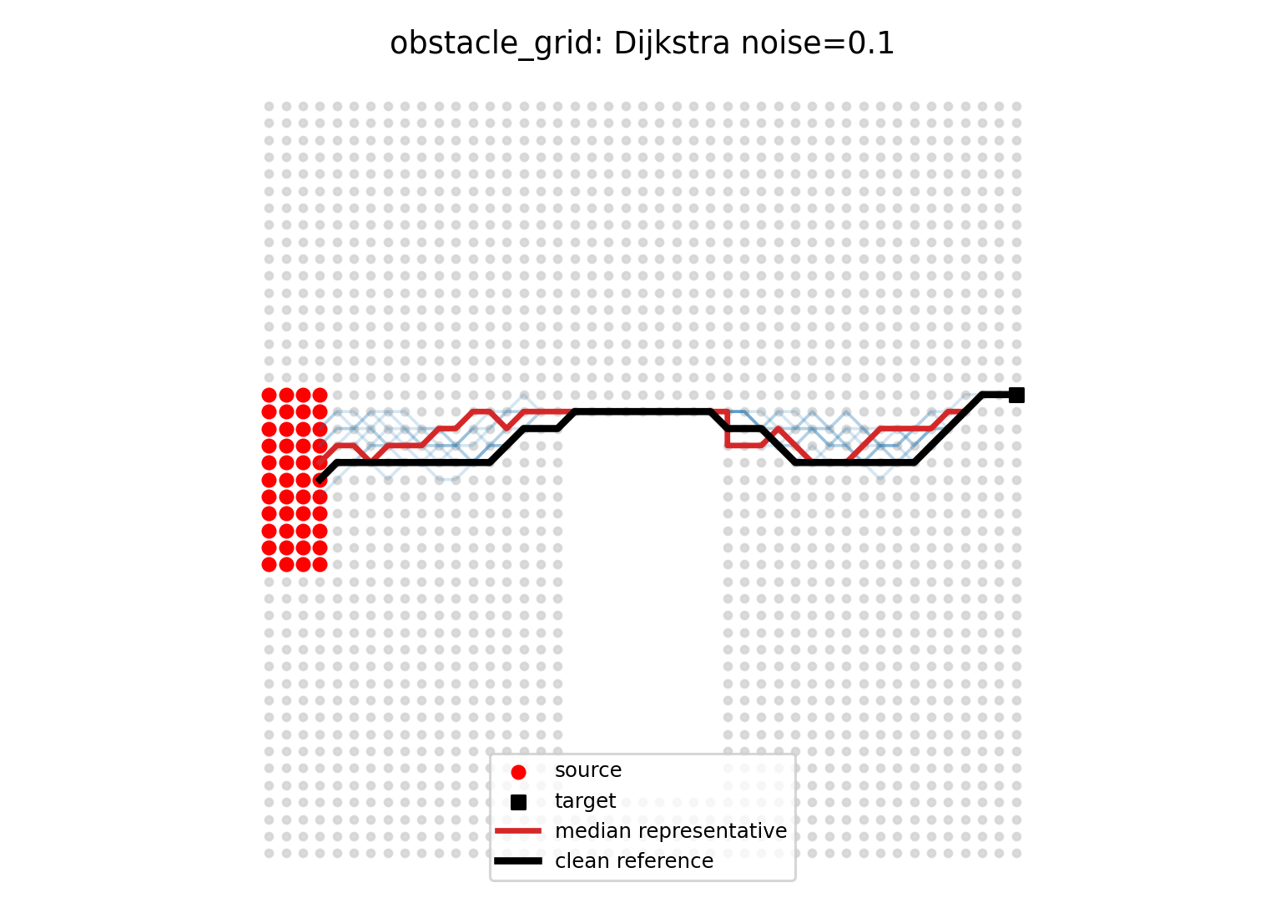
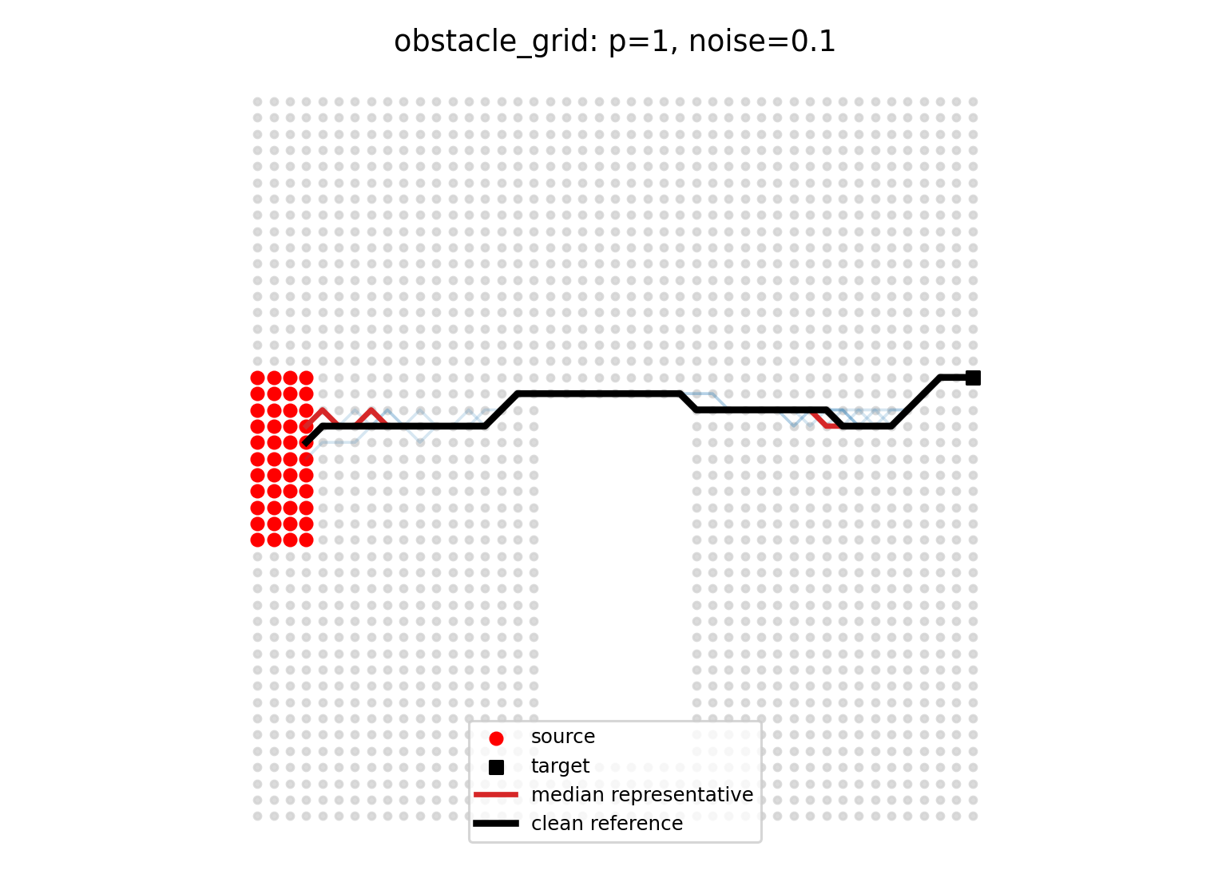
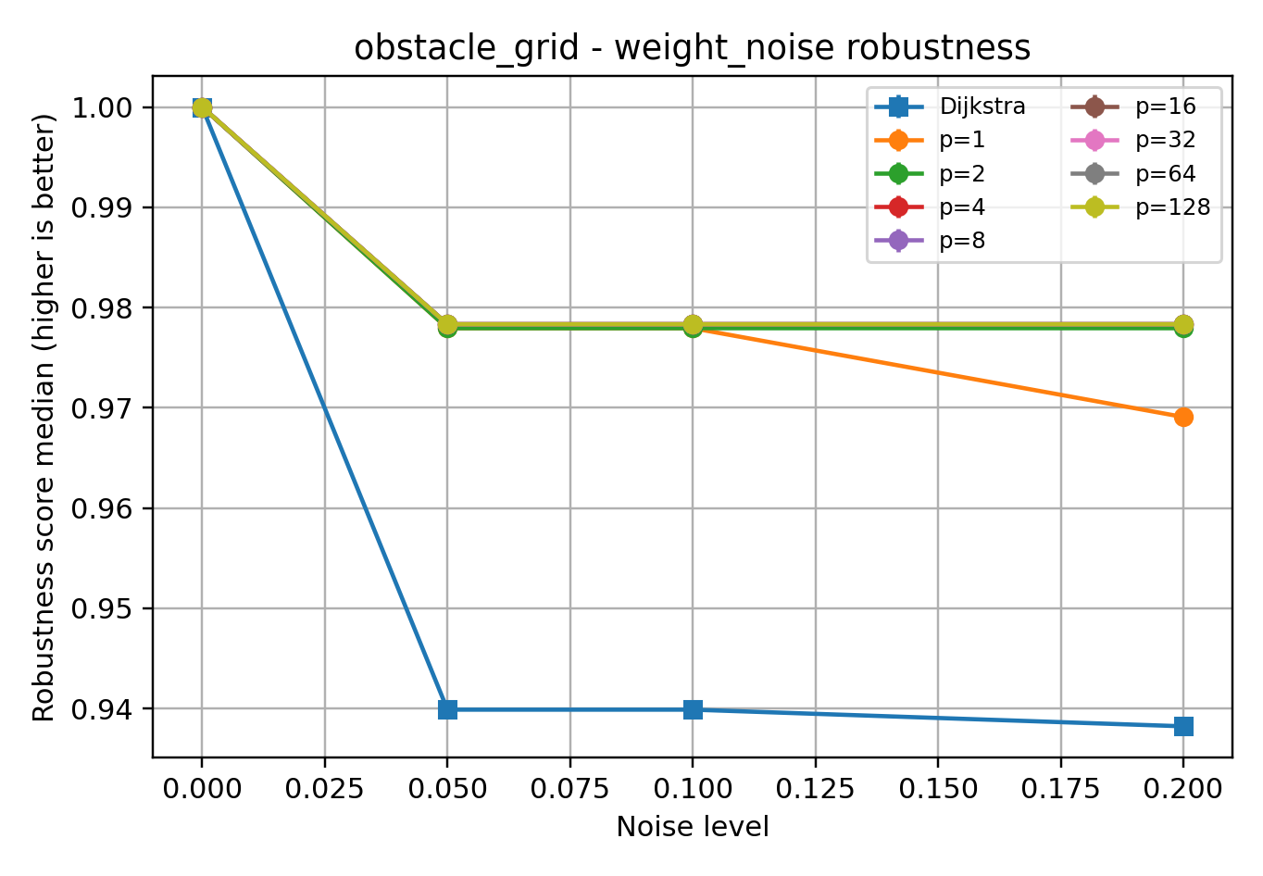
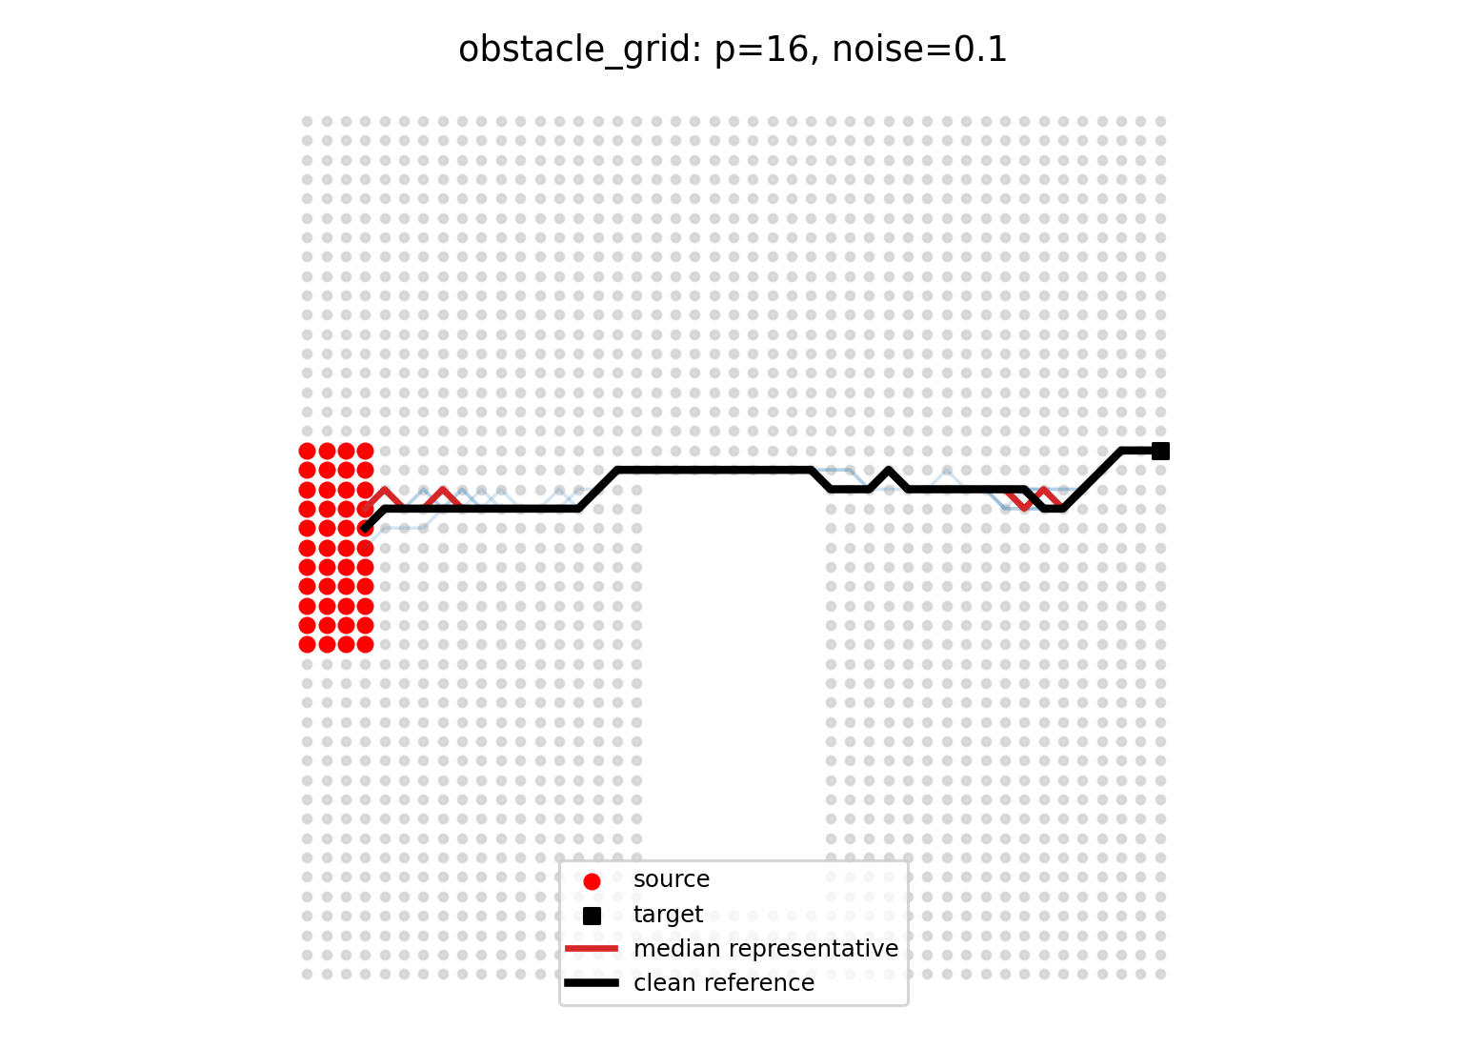

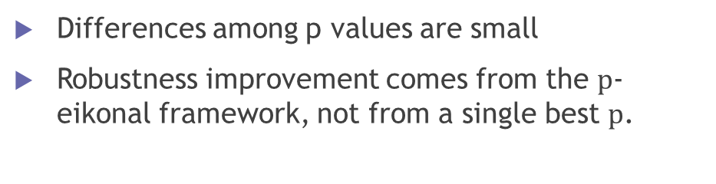
Results and Discussion 4:
Obstacle grid
Differences among p values are small
Robustness improvement comes from the $p$-eikonal framework, not from a single best $p$.
Dijkstra shows local deviation under noise
p-eikonal paths almost overlap with clean reference

Slide 17
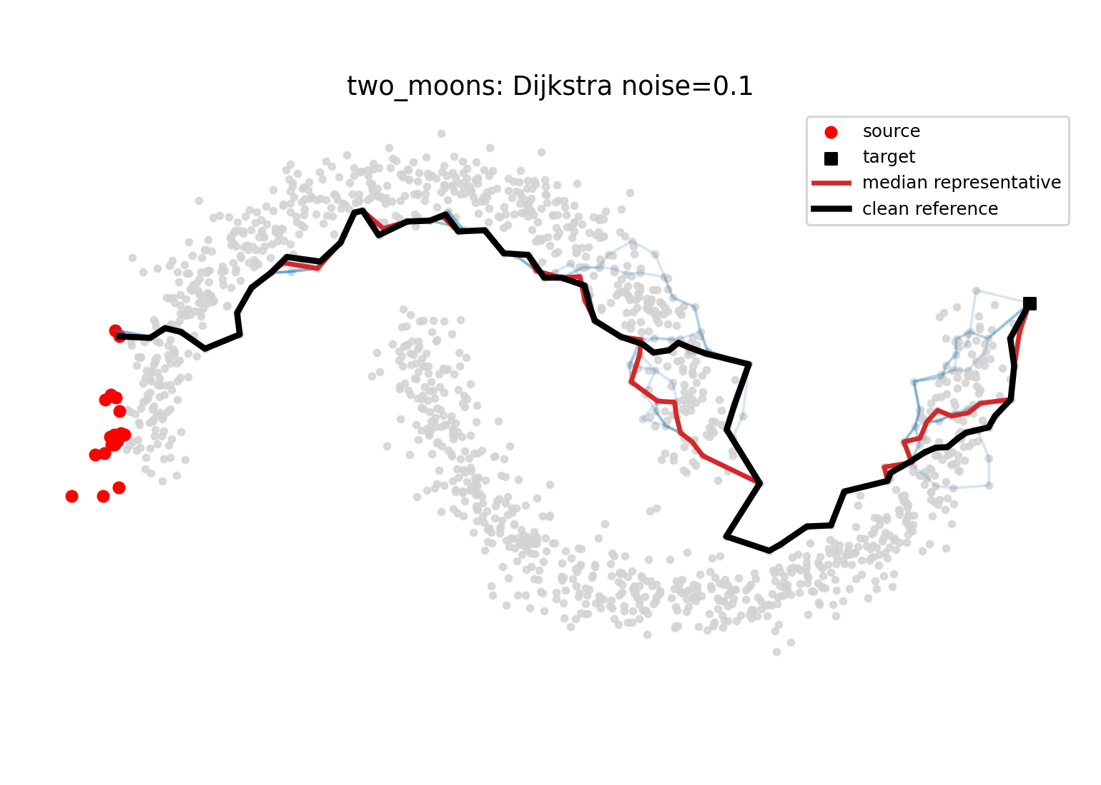
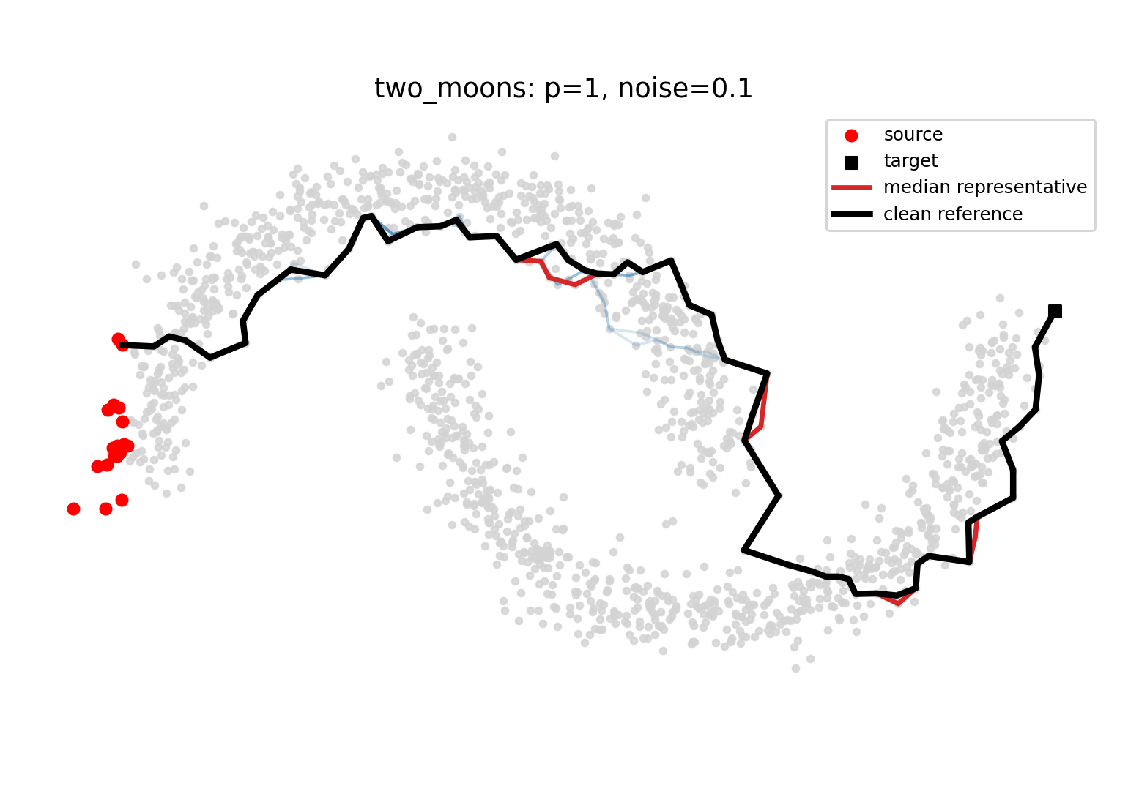
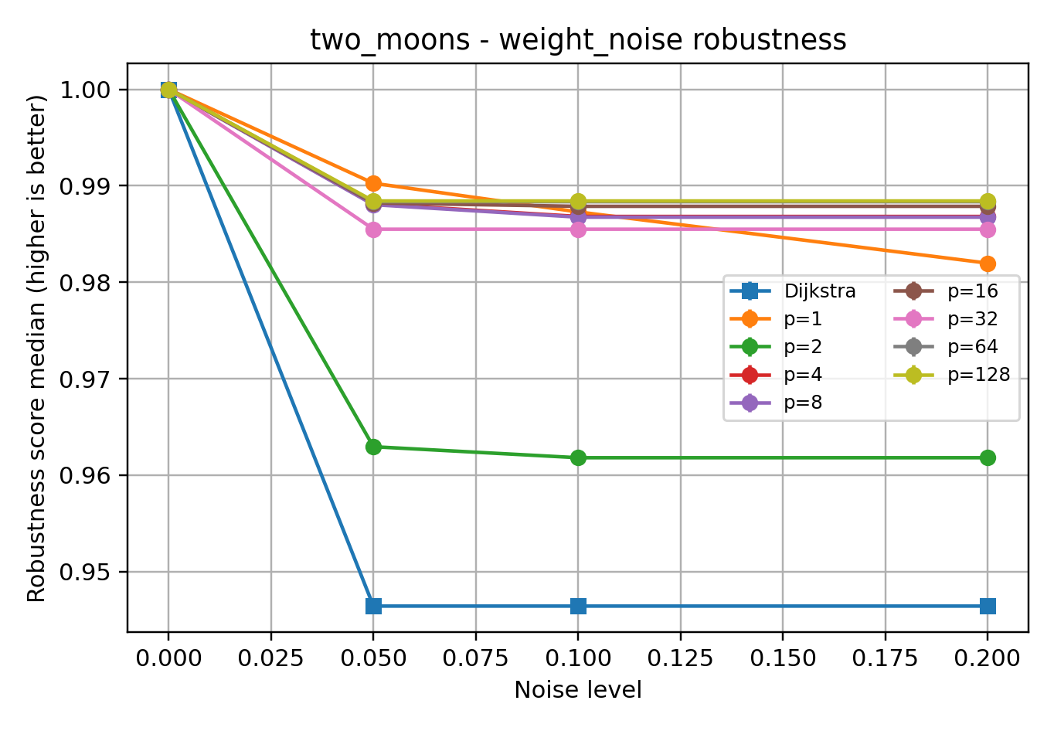
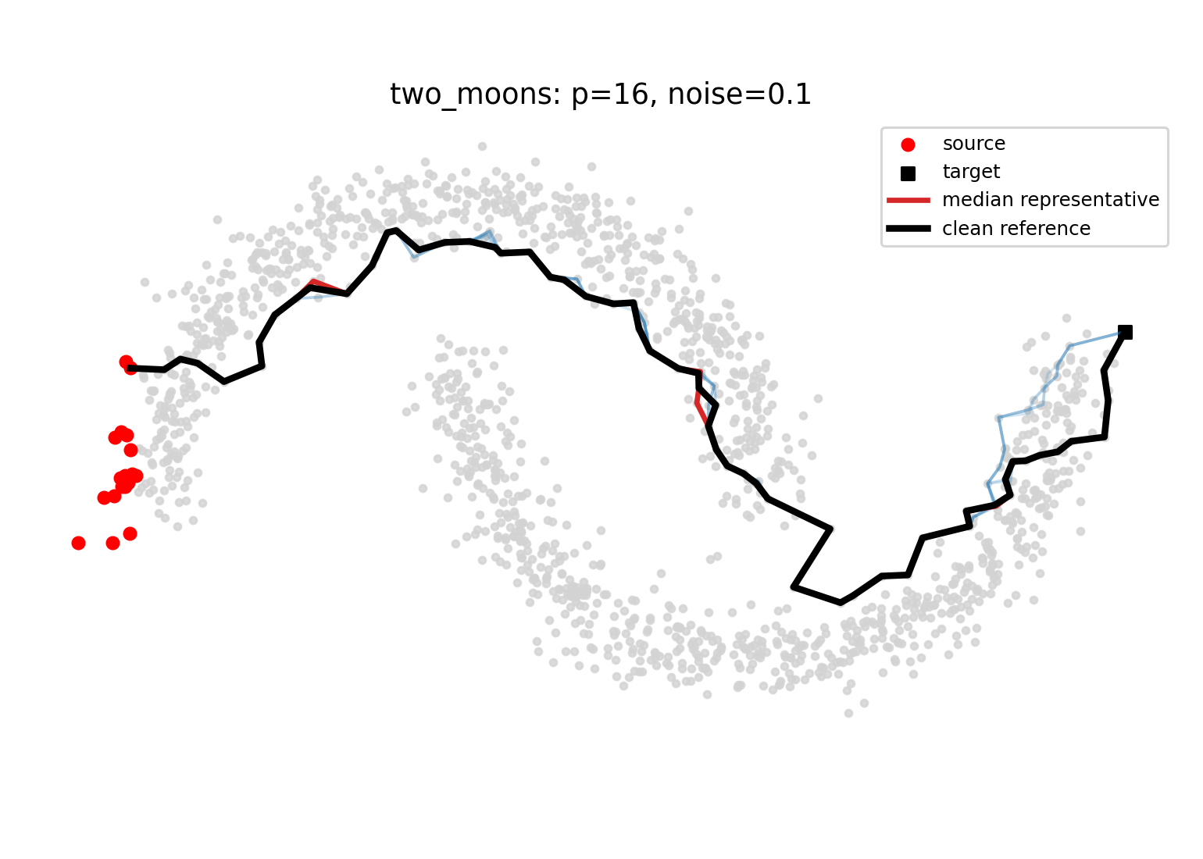
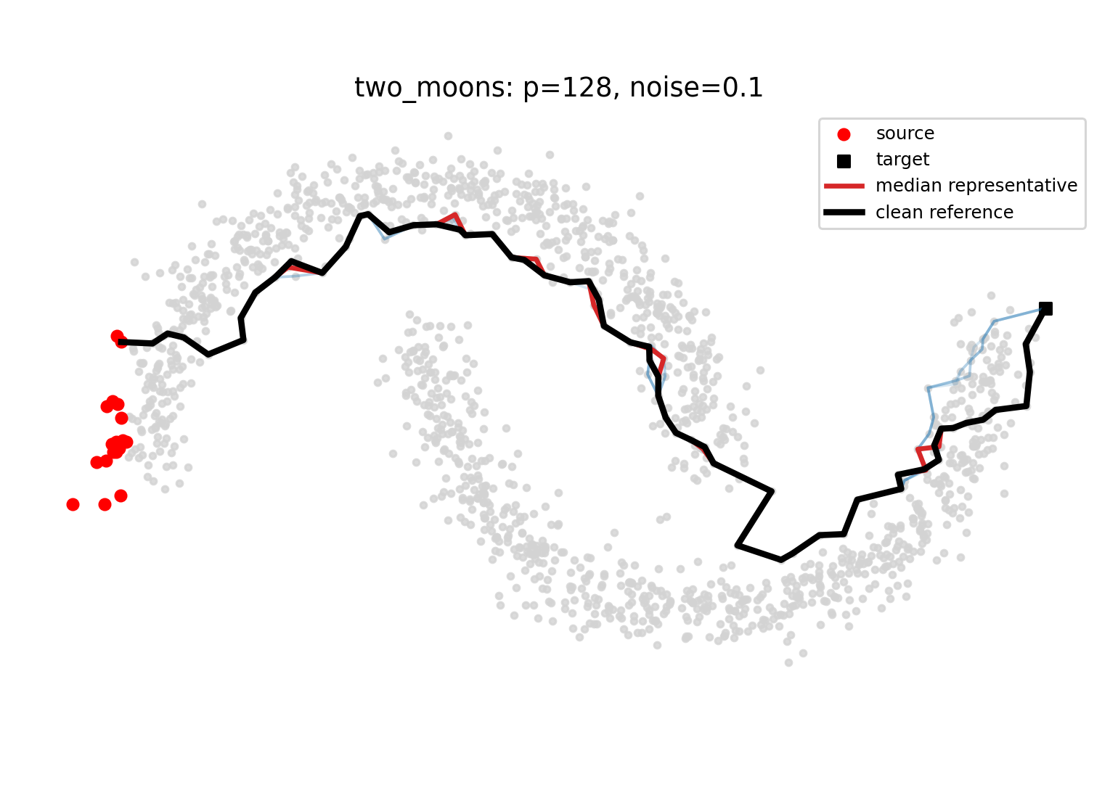
Results and Discussion 5:
Two Moons
Dijkstra shows visible path deviation under noise
P has a stronger influence on both path shape and robustness
Larger p values show higher robustness in this dataset
p-eikonal propagation is more stable than discrete shortest-path selection

Slide 18
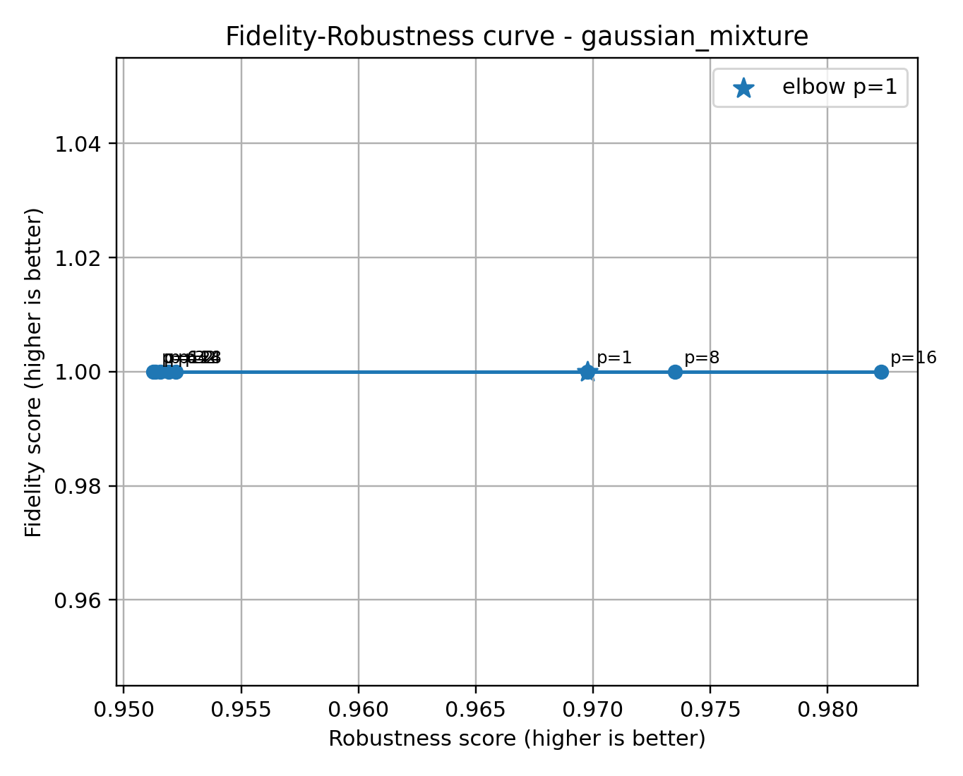
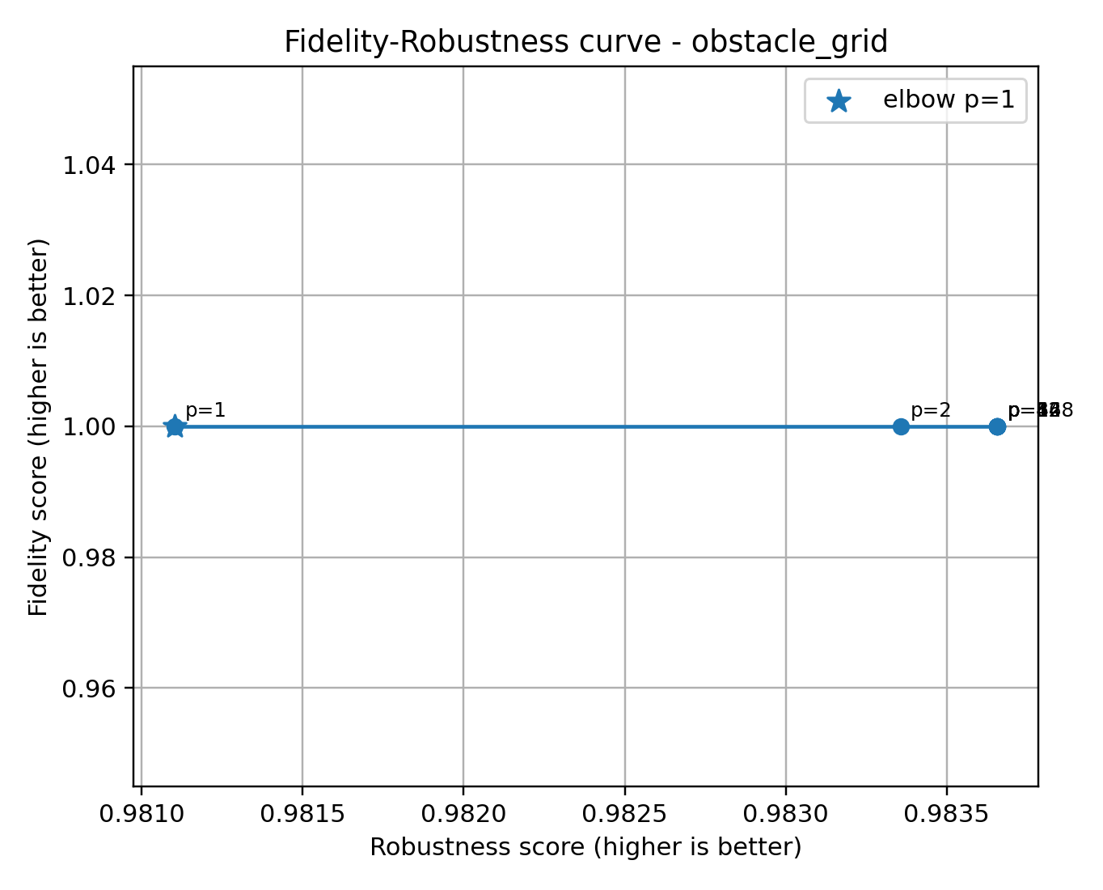
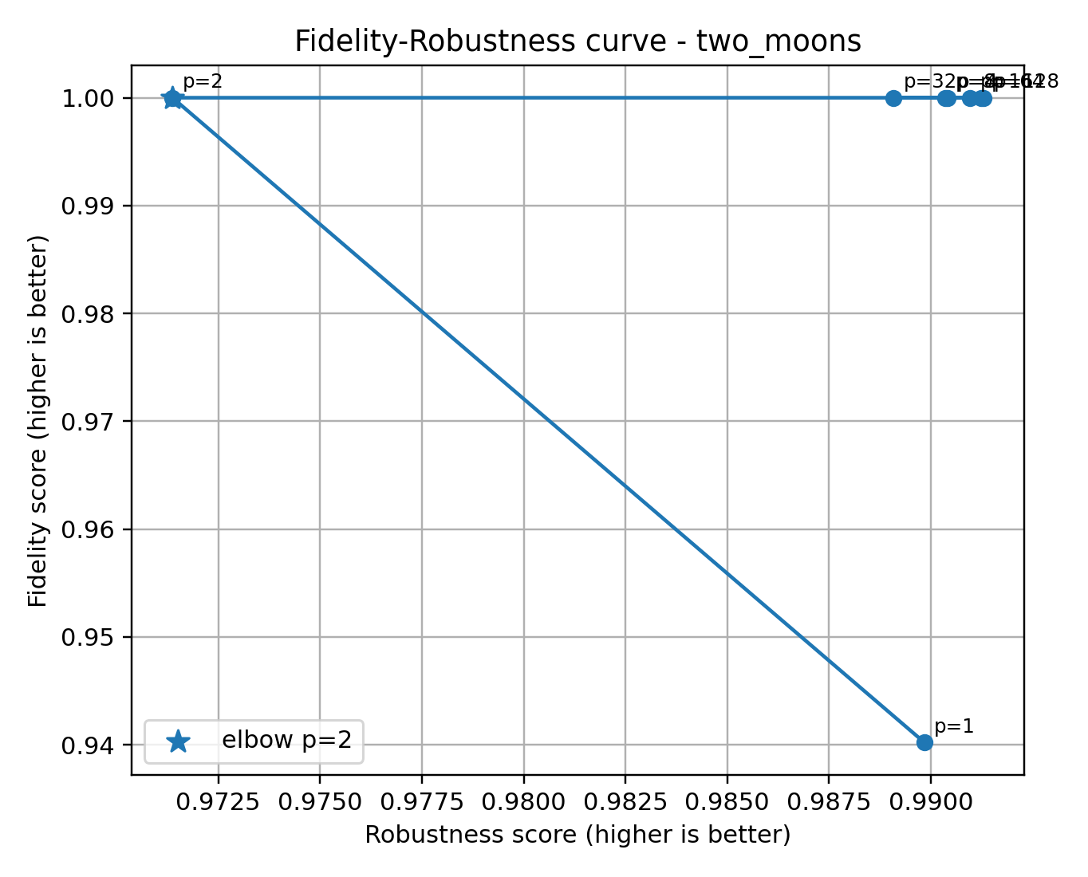
Results and Discussion 6:
Fidelity–Robustness Trade-off
No universally optimal p: Many p values perform similarly well
P has a stronger influence on both path shape and robustness
Parameter selection should focus on a stable range, not a single best value

Slide 19
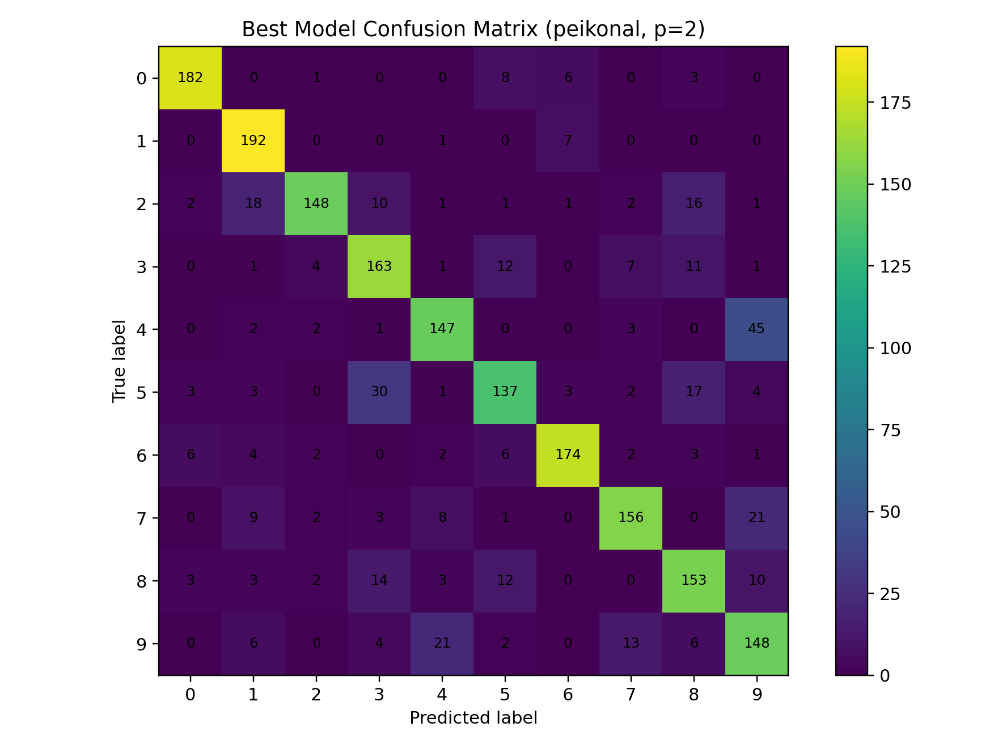
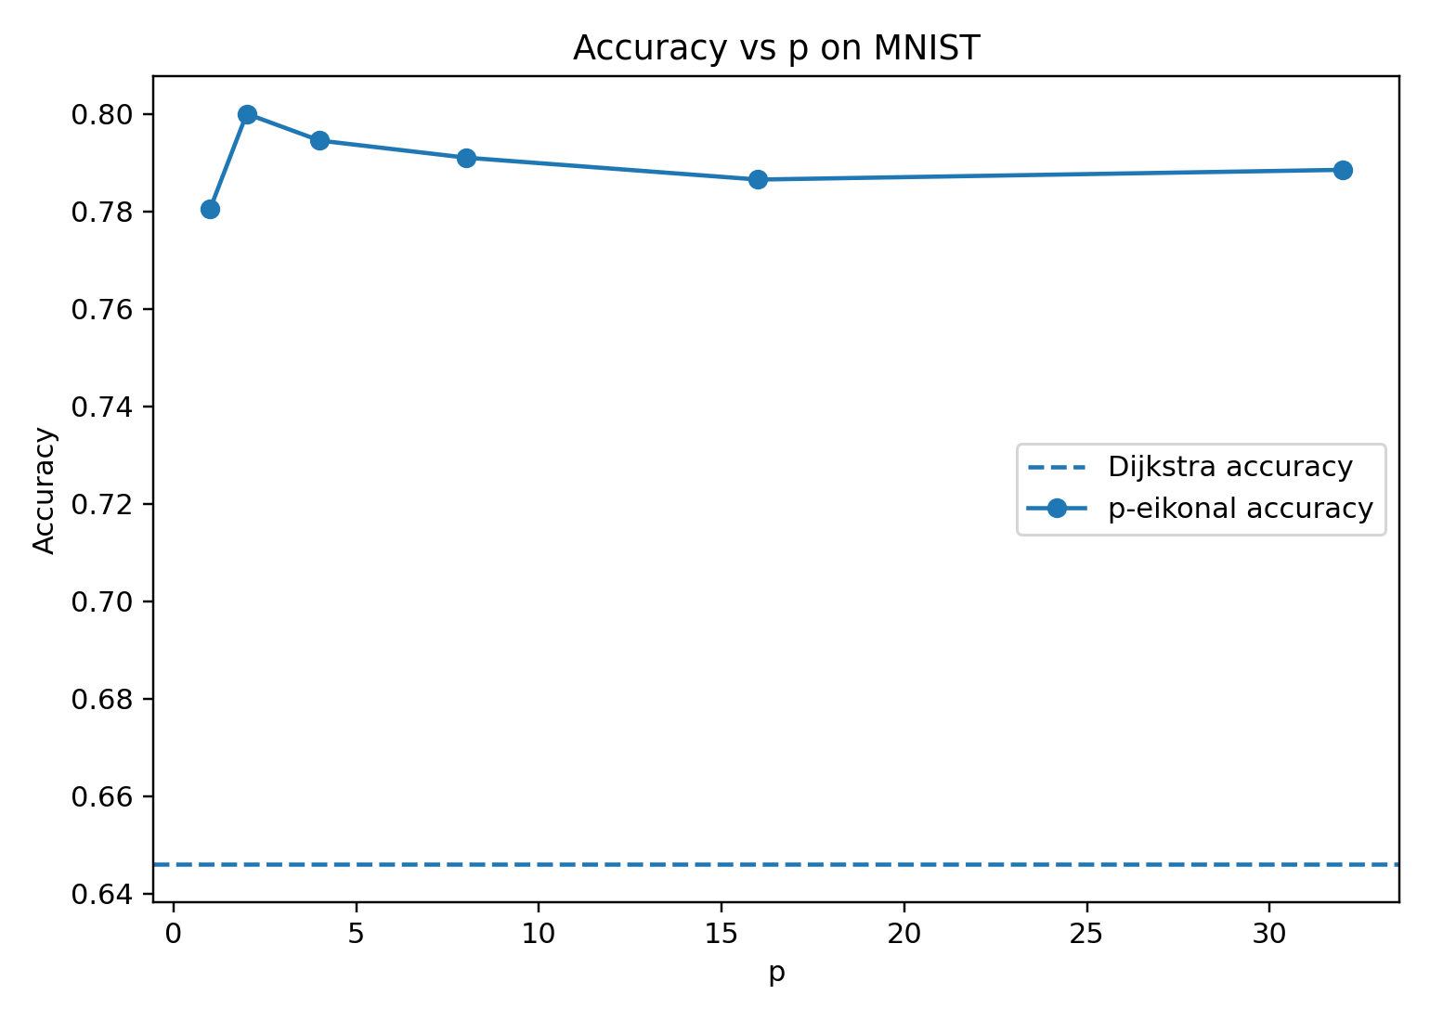
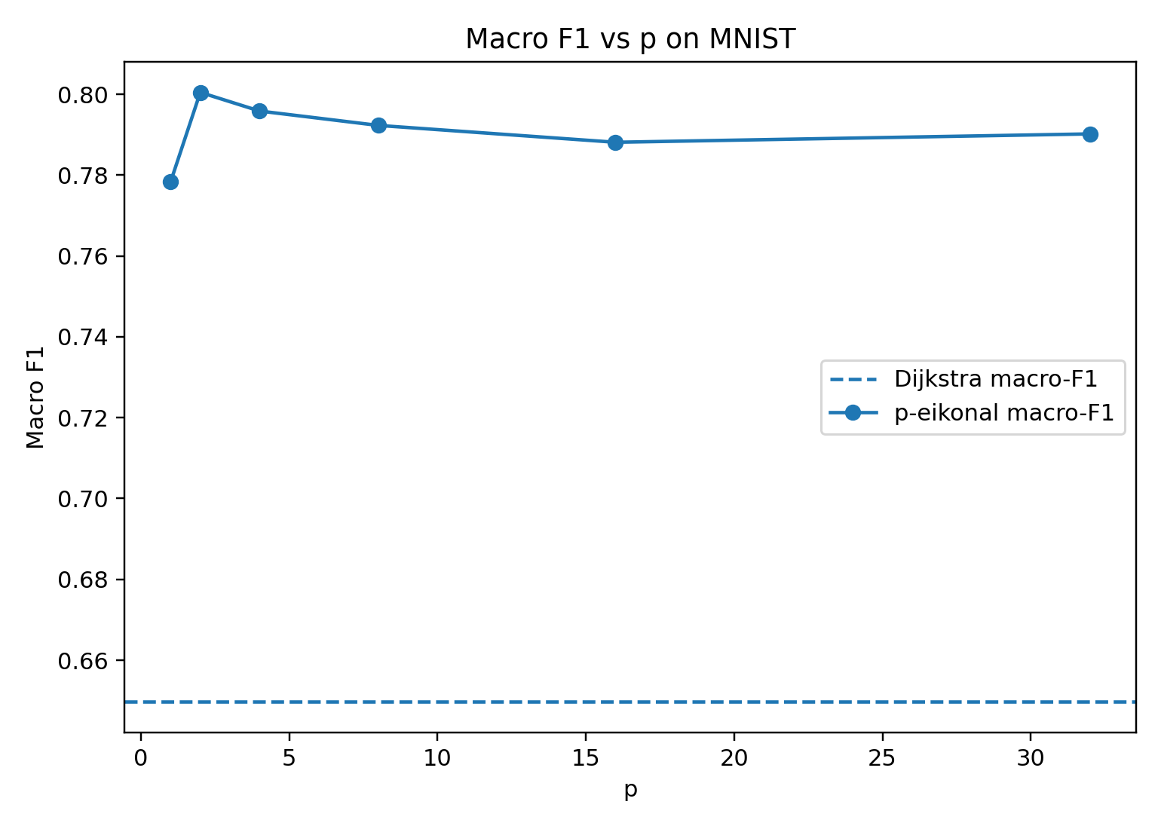
Results and Discussion 7:
Test on MNIST
The confusion matrix shows that most digits are correctly classified along the diagonal.
The main errors occur between visually similar digits, such as 4 and 9
Dijkstra: significantly lower accuracy and Macro-F1
Best p: p = 2
p eikonal models perform better across all tested p

Slide 20
Thank you for your attention!
Questions and Suggestions Are Welcome.

